Slide 1







Semantic Knowledge Extraction
Peter Murray-Rust, pm286@cam.ac.uk
Yusuf Hamied Dept of Chemistry, Univ. of Cambridge, UK.
Gitanjali Yadav, gy246@cam.ac.uk
Nat. Inst. Plant Genome Research, New Delhi, IN
CompbioMPhil 2023/4, Cambridge, UK, 2024-01-17
Plants, Chemistry, Climate, Software, Corpora, Semantics, Community
Laptop-friendly, OpenNotebookScience, OpenAccess
Images from PMR CC-BY and Wikimedia CC BY-SA

Slide 2
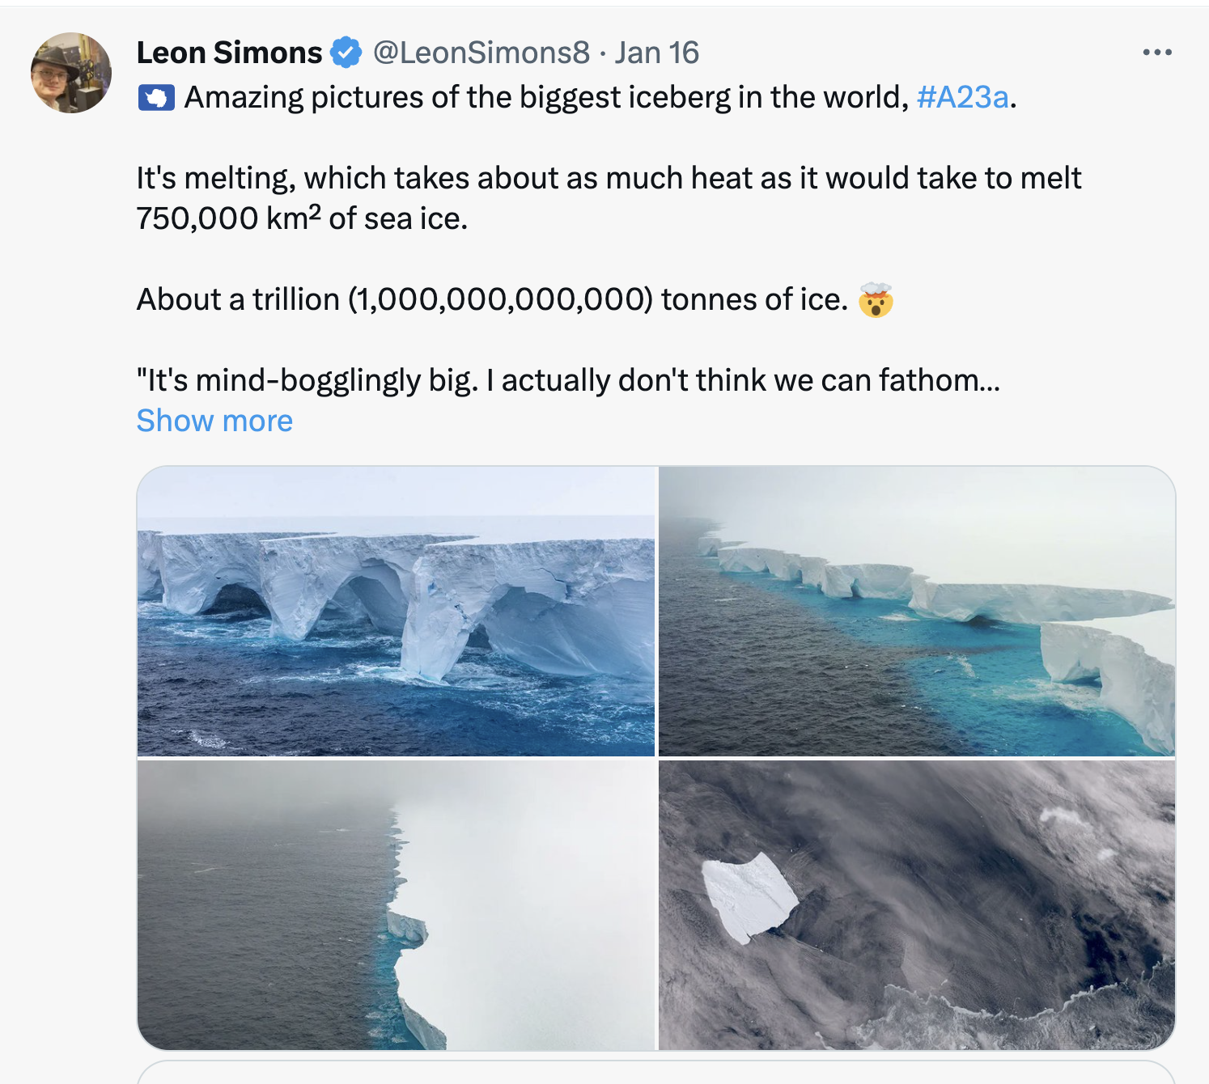
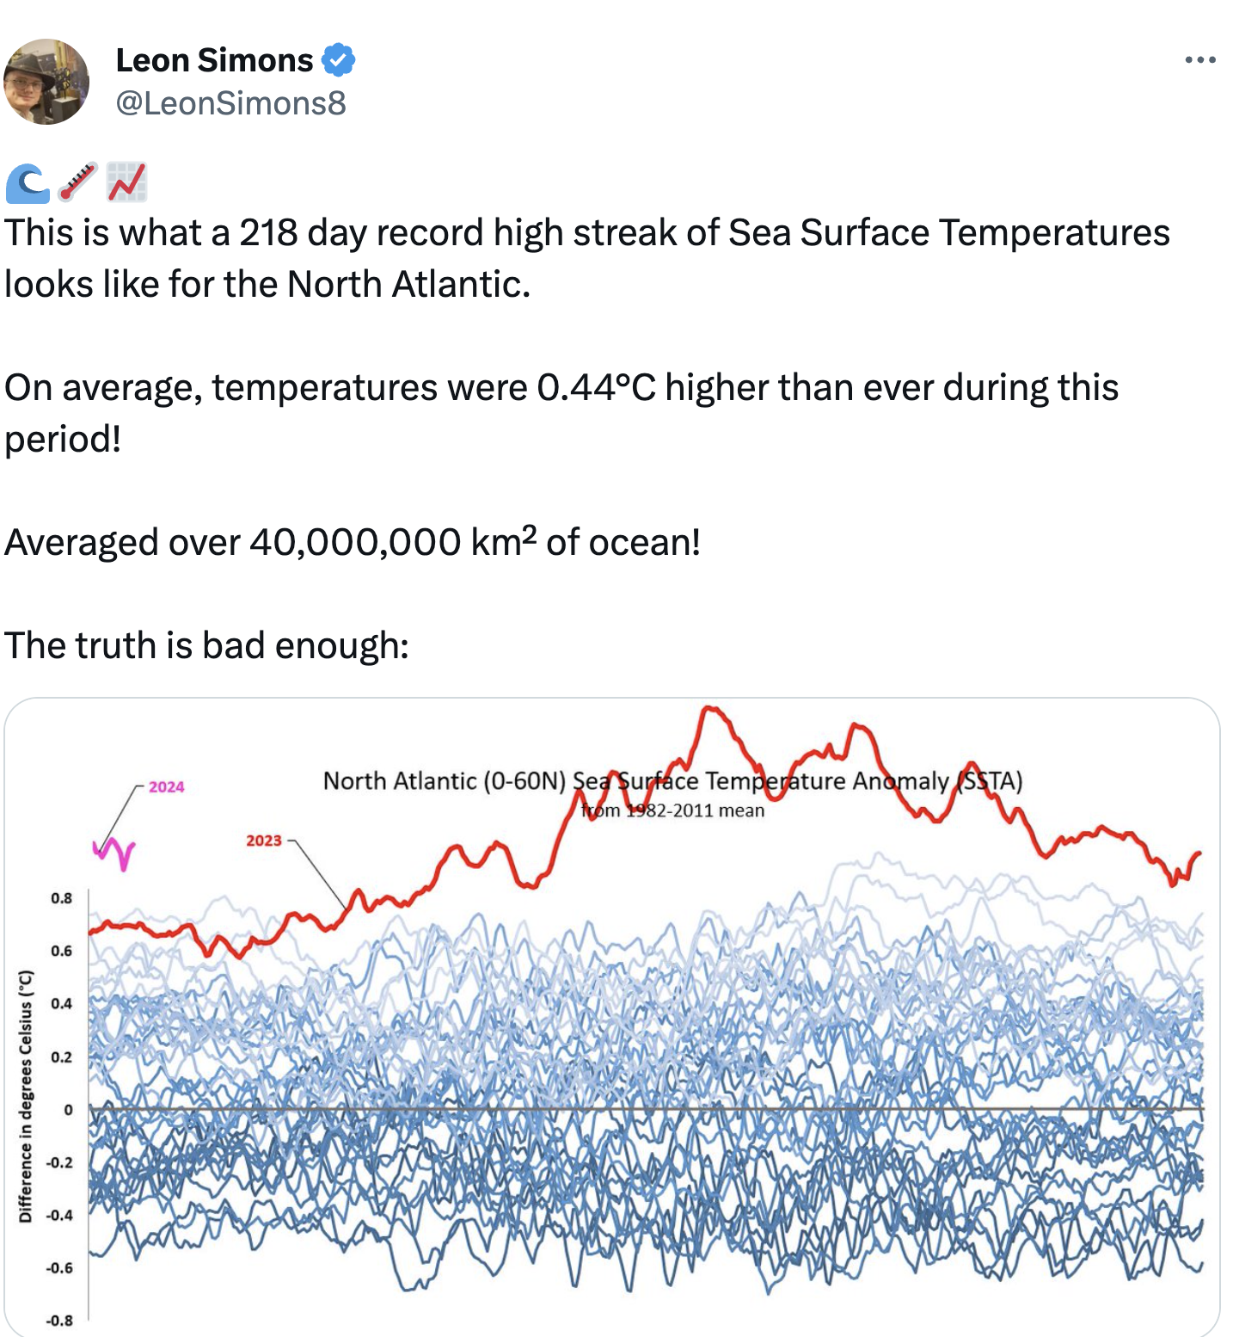
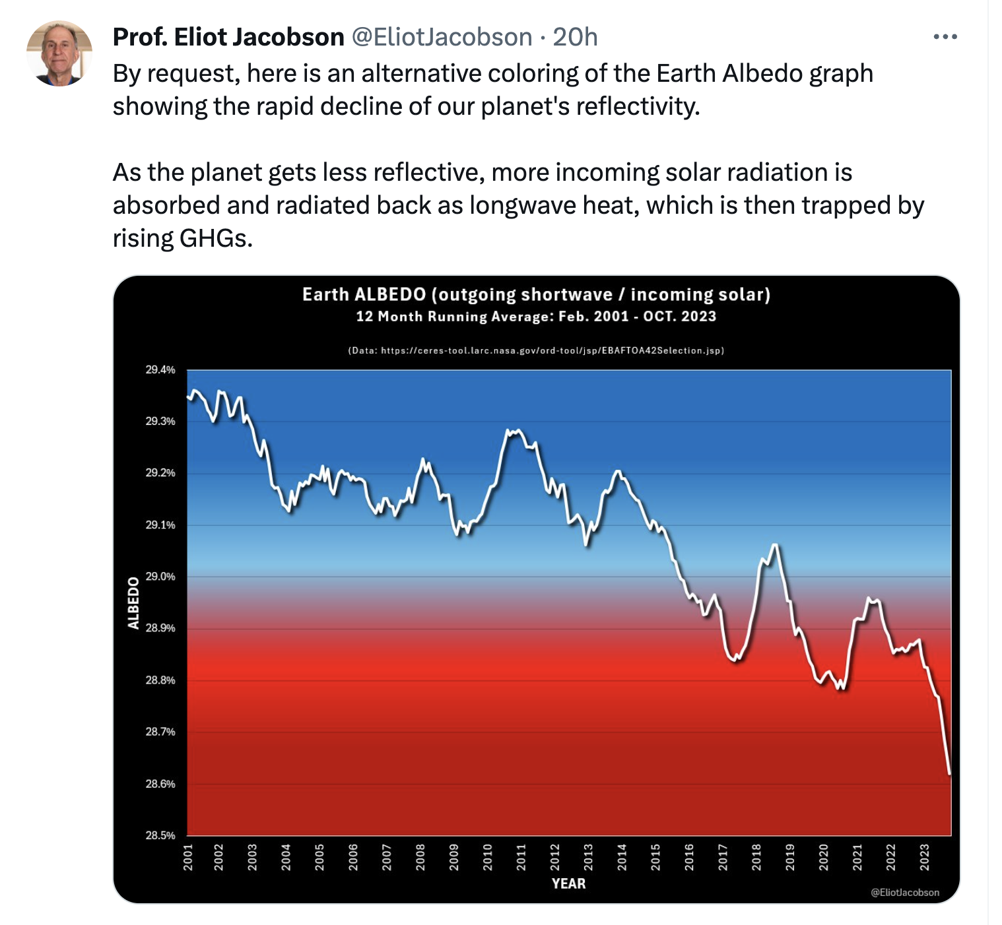
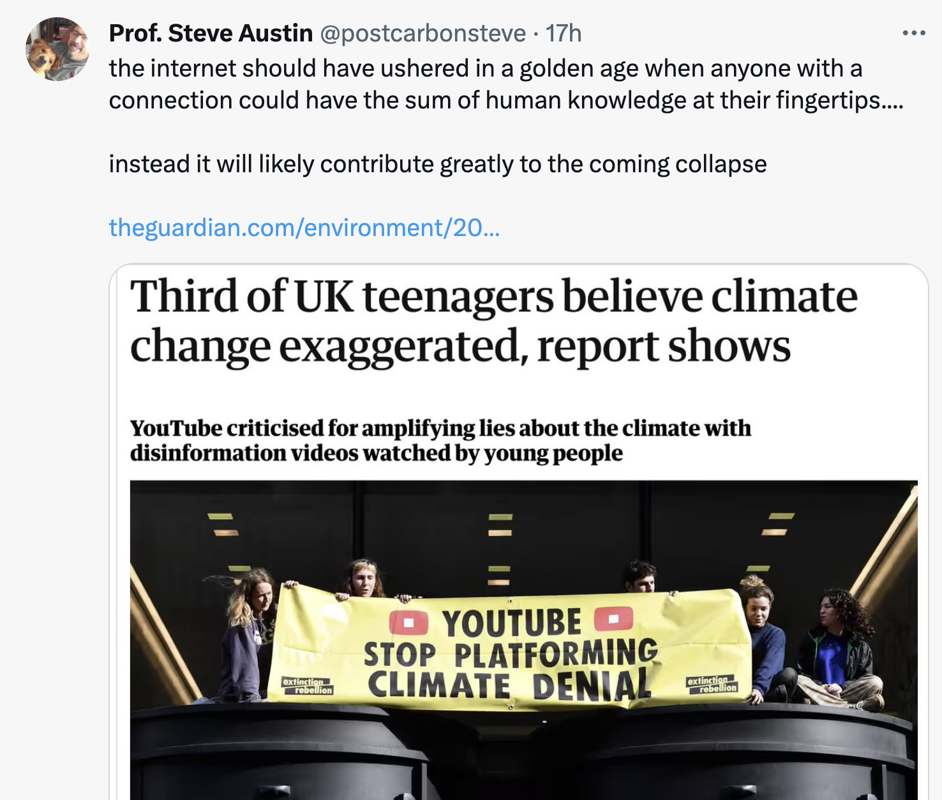
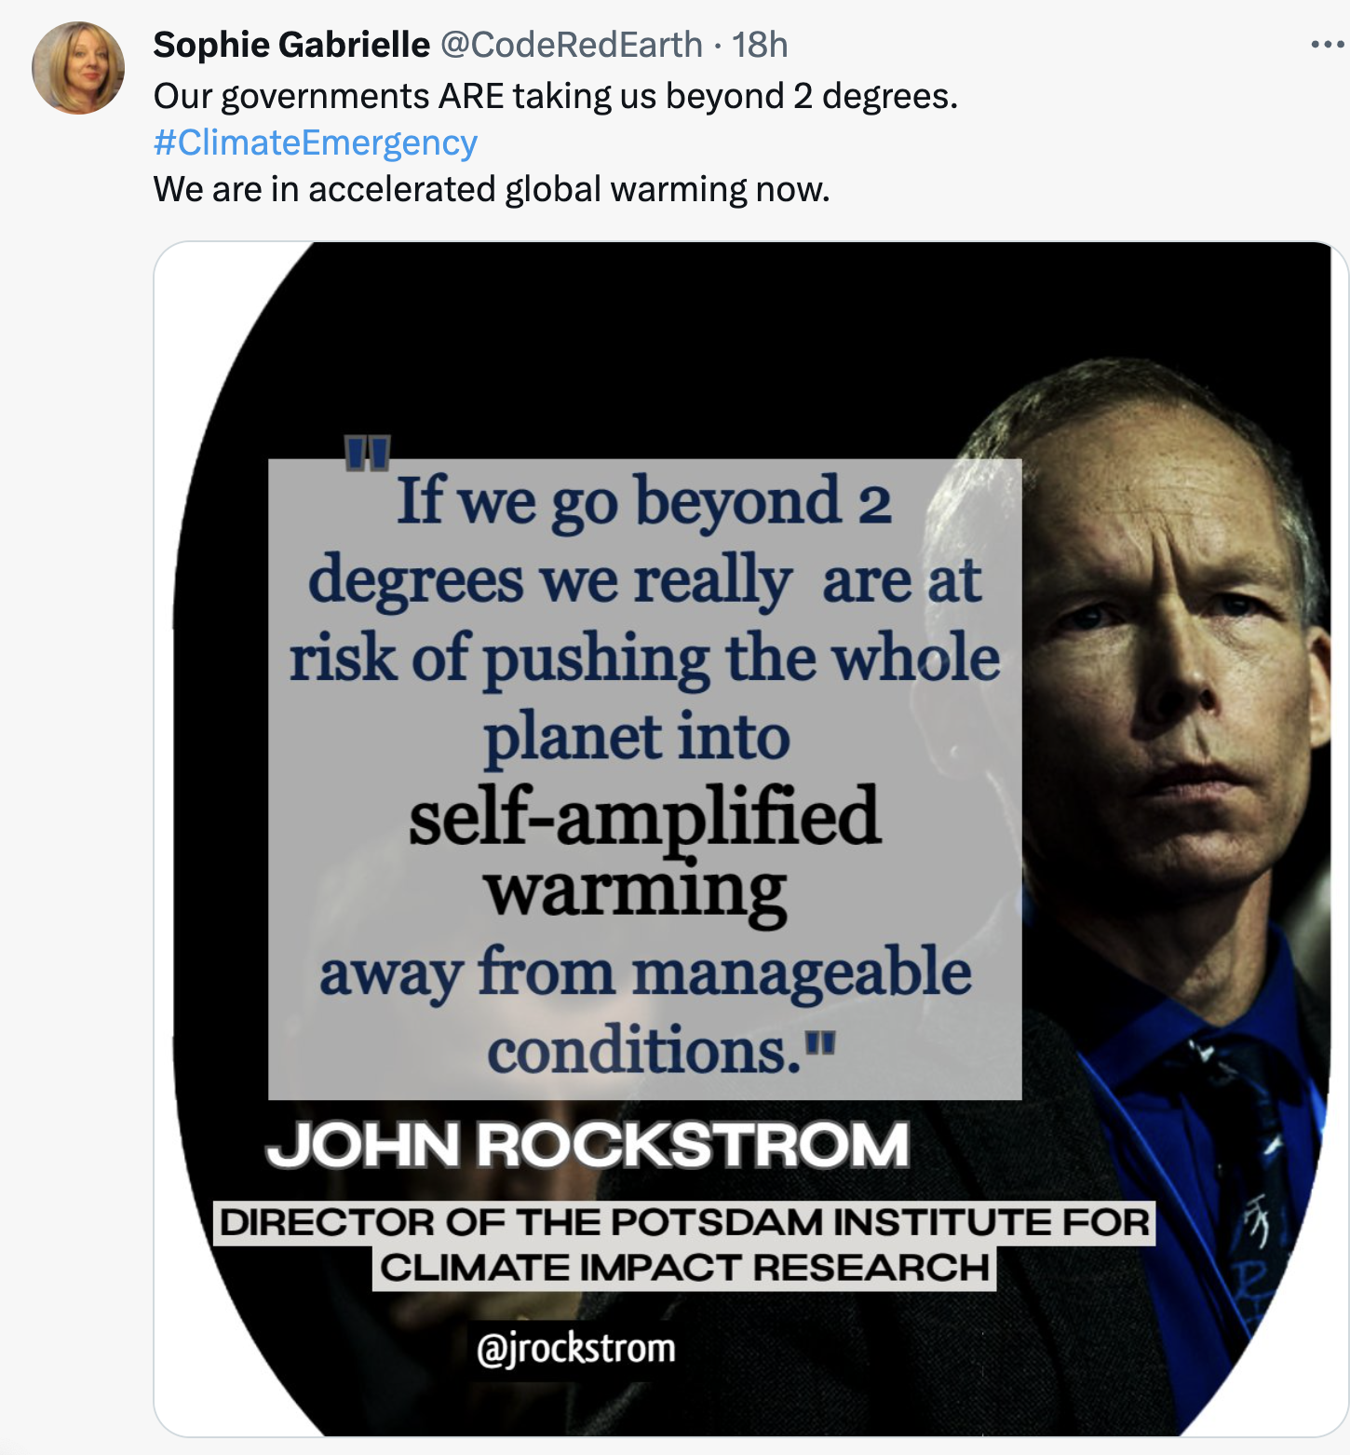
Climate tweets 2024-01-17

Slide 3
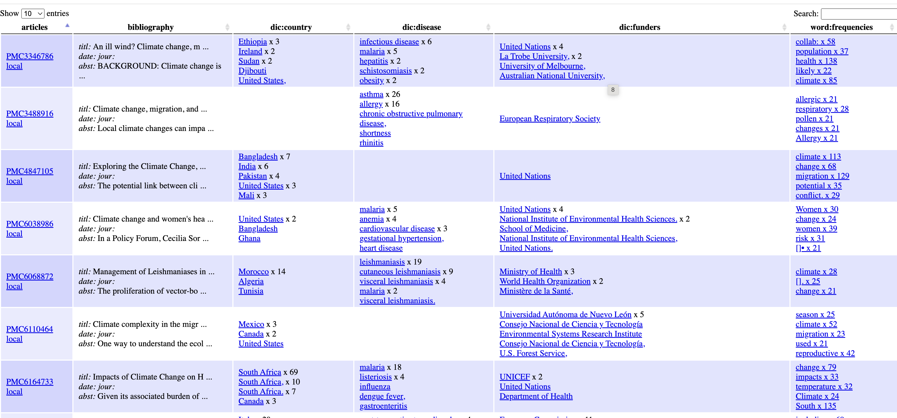
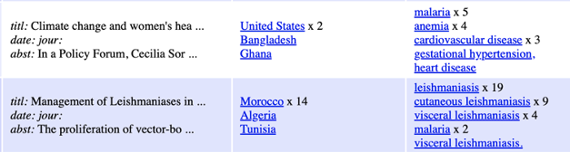
Disease and Climate
5 mins, 300 articles
unsupervised
supervised
PMCarticle
country
disease
funders

Slide 4
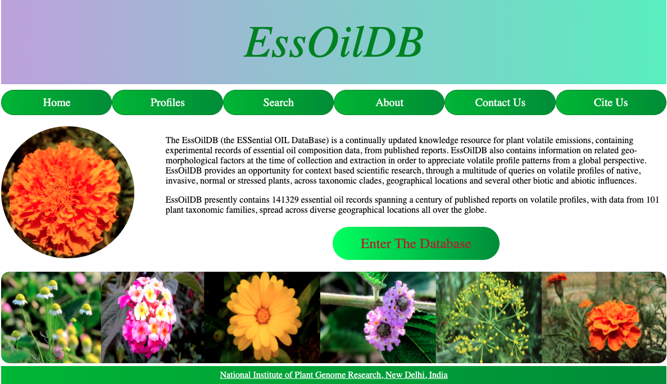
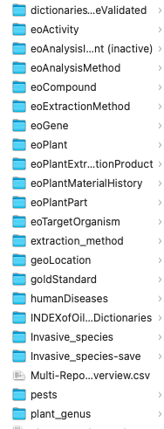
dictionaries
Essential Oil Database Manually extracted from Literature;
Gitanjali Yadav and colleagues, NIPGR, New Delhi

Slide 5
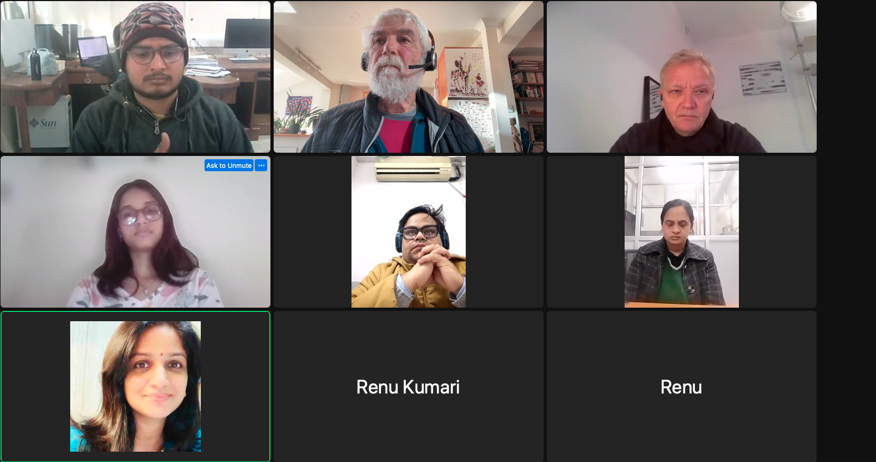
semanticClimate team meeting 2024-01-15
Zoom, Slack, Github repos + discussion, Google Colab, PyPI

Slide 6
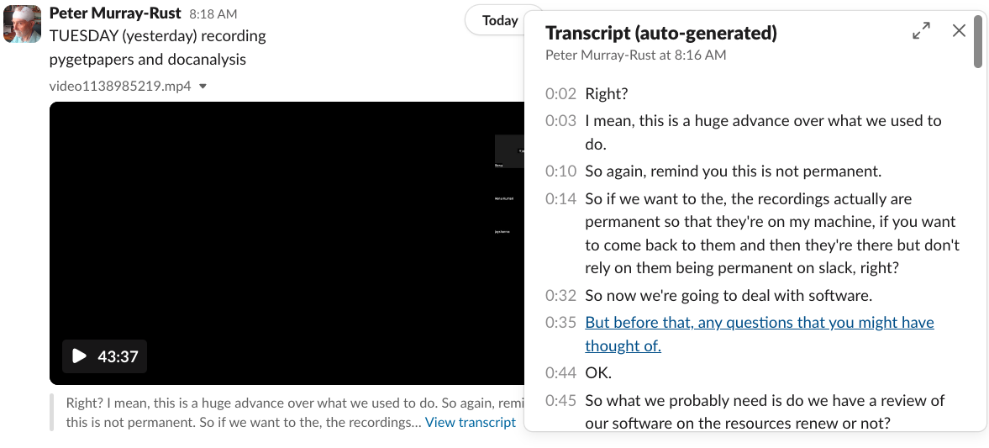
Daily recording and transcript of sessions
Zoom
Slack?

Slide 7
Demos/Resources
Anuv Chakraborty: Phytochemical Knowledge from Images https://github.com/petermr/pyamiimage/blob/main/presentations/2021_11_06_InCoB_2021.pdf
Simon Worthington: IPCC Glossary https://vivliostyle.vercel.app/#src=https://raw.githubusercontent.com/semanticClimate/glossary-demo/main/html/index.html
Shweata Hegde: IPCC Glossary Knowledge Graph https://tibhannover.github.io/semanticclimate/ipcc_glossary.html
Fuller list of videos, software, semantic resources at: https://semanticclimate.github.io/p/en/posts/resources/

Slide 8
Possible projects
Software: NLP , image extraction, knowledge graphs, semantic dictionaries
Subjects: phytochemistry and/or climate
Knowledge: Literature corpora, Dictionaries, IPCC/UNFCCC conversions

Slide 9
Links and Thanks
content and software(many repos) https://github.com/petermr
UNFCCC: https://unfccc.int/
UN/IPCC: https://www.ipcc.ch/
NIPGR: https://nipgr.ac.in/home/home.php
Wikimedia DE: https://www.wikimedia.de/
TiB Hannover: https://www.tib.eu/en/?lang=en
PMR/UnivOfCam group software: https://opsin.ch.cam.ac.uk/ http://www-pmr.ch.cam.ac.uk/wiki/Oscar3 https://chemicaltagger.ch.cam.ac.uk/

